Slide 1
Warwick Valley CSD
Facilities Committee Meeting
June 6, 2024

Slide 2
Agenda
I. | Approval of Minutes
II. | Capital Project Update (Than Harrington)
III. | Convergent (Battery Storage Update)
IV. | Capital Project Maximum Size
V. | Capital Project overview
VI. | Capital Funding/Financing
VII. | Roofing
VIII. | Security Interior/Exterior Door Estimates Park Avenue School (Capital Project) Sanfordville $100,000 Project 2024-25 Interior Doors – In-house vs. Capital General Fund Safe Act Funding
IX. | Propositions
X. | Process/timeline

Slide 3
Capital Project Update
Than Harrington
Park Windows
MS Outdoor Bathroom
SE Outdoor Bathroom
HS Unit Ventilators
MS Locker room
HS Auditorium
HS Wrestling room

Slide 4
Convergent (Battery Storage Update)
Dr. Leach (Battery Storage Update)

Slide 5
Capital Project Maximum Project
Current Maximum Project Allocation
Updated Maximum Project Allocation
Capital Project | Max Project | $8,558,564
Building Aid | 63.8% | $5,460,364
Net Difference |  | $3,098,200
Reserve |  | $3,098,200
Additional Tax |  | $0
Capital Project | Max Project | $14,083,426
Building Aid | 63.8% | $ 8,985,226
Net Difference |  | $ 5,098,200
Reserve |  | $ 5,098,200
Additional Tax |  | $0
Additional 2 million dollars in reserve, gives the District an additional $5,524,862 in Capital work.

Slide 6
Capital Project Overview
Proposition 1
Contract | Building | Total
Roofing | HS | $4,424,000
Electrical Panel | HS | $1,000,000
HVAC Gym | HS | $1,000,000
HVAC | HS Jr High Wing/Main office | $ 1,100,000
Roofing | MS (DO) | $ 860,000
Roofing | Park | $ 460,000
Windows | Park | $1,000,000
Plumbing | Park | $ 100,000
Roofing | Pine Island | $ 760,000
Security | HS/MS Exterior Doors | $ 750,000
Sub Total |  | $11,454,000
Incidentals 22.95% | Increase prices, Engineering, CM, other costs | $2,629,426
Grand Total |  | $14,083,426
Proposition 2
Contract | Building | Total
Roofing | Kings | $1,041,159
Grand Total |  | $1,041,159

Slide 7
Capital Project Financing 2024
Funding
Proposition 1 |  | Projected
Maximum Project |  | $14,083,426
Capital Project Reserve |  | $ 5,098,200
Building Aid | 63.8% | $ 8,985,226
Proposition 2 |  | Projected
Maximum Project |  | $1,041,159
Repair Reserve |  | $1,041,159
Project | Amount
Proposition 1 | $14,083,426
Proposition 2 | $ 1,041,159
Total Project | $15,124,585
Total Project | $15,124,585
Capital Reserve | $5,098,200
Repair Reserve | $1,041,159
Finance Amount | $8,985,226
Building Aid 63.8% | $8,985,226
Additional Taxpayer contribution | $0

Slide 8
Capital Project - Roofing
Building | Square Feet |  | Building | Square Feet
High School |  |  | Middle School
Jr High Section | 22,000 |  | District Office | 21,500
Old Gym | 8,000 |  | Total | 21,500
Pool | 8,000
New Gym | 13,000 |  | Pine Island
Weight Room | 5,100 |  | Entire Building | 19,000
Science Wing | 22,000
Back left Section | 32,500 |  | Total | 19,000
Total | 110,600
Park |  |  | Kings
Original Building | 11,500 |  | Partial | 20,000
Total | 11,500 |  | Total | 20,000
 |  |  | Grand Total | 182,600

Slide 9
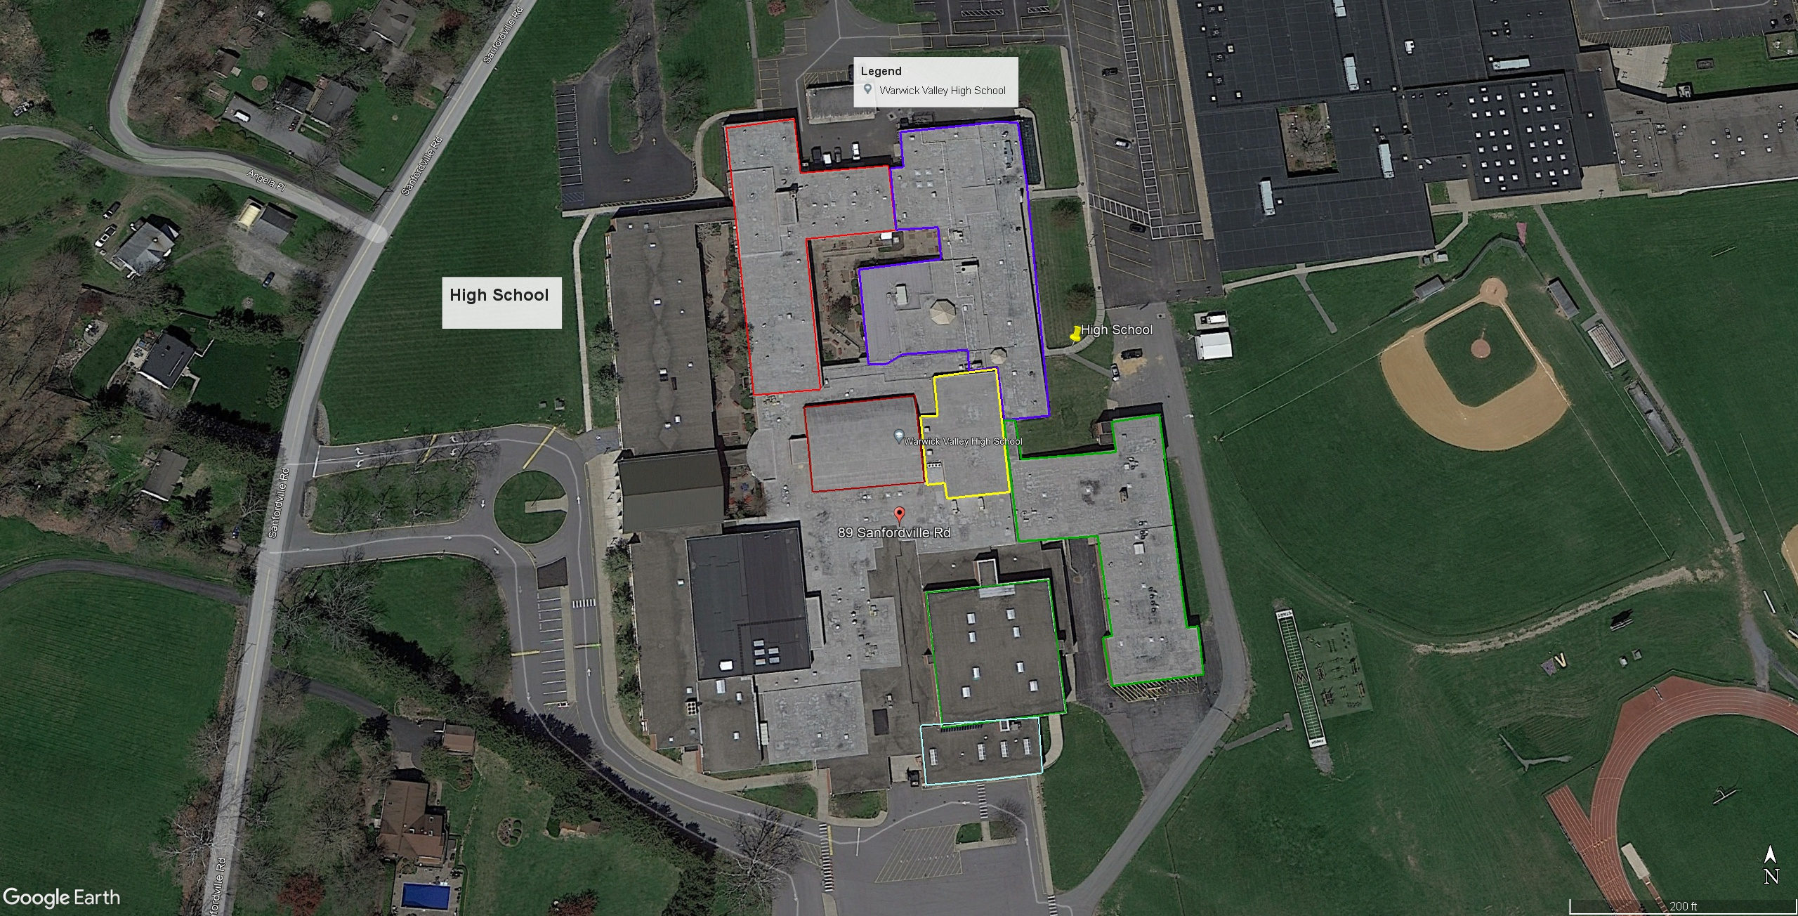
Capital Project - Roofing
High School
HS Jr High Section 22,000 Sq. ft.
HS Old Gym 8,000 Sq. ft.
HS Pool 8,000 Sq. ft.
HS New Gym 13,000 Sq. ft.
Weight Room 5,100 Sq. ft.
Science wing 22,000 Sq. ft.
Northeast corner 32,500 Sq. ft.

Slide 10
Security
District Wide Security
Hardening Exterior Doors HS/MS
Interior Doors HS/MS/SE/Park (In-house)
Interior Doors | Approx. Count
High School | 200
Middle School | 100
Sanfordville | 77
Park | 51
 | 428
Exterior Doors | Approx. Count
High School | 55
Middle School | 45
Sanfordville | 32
Park | 15
 | 147

Slide 11
Security
Park 2023-24
Sanfordville 2024-25
Hardening Exterior doors (15)
Window replacement (original building)
Window bullet resistant film
Funding (Capital Project) $718,000.00
2023-24 $100,000.00
Safe Act Funds $ 75,000.00
Grand Total $893,000.00
Hardening Exterior doors (32)
Courtyard doors hardening
Door frame repair/replacement
Window bullet resistant film
Funding (2024-25) $100,000.00
Safe Act Funds $160,000.00
Grand Total $260,000.00
Park Interior Doors 2023-24
Interior Doors ordered $29,891.00
Ordered interior Security Hardware $65,542.60
Safe Act Funds $51,000.00
Net Costs $14,542.60
Sanfordville Interior Doors 2023-24
Ordered interior Security Hardware $110,198.95
Safe Act Funds $ 77,000.00
Net Costs $ 33,198.95

Slide 12
Proposition 1
PROPOSITION 1
RESOLVED, that the Board of Education of Warwick Valley Central School District, Orange County, New York, is hereby authorized to reconstruct and construct improvements to various School District buildings and facilities, including, site work, original furnishings, equipment, machinery, apparatus, appurtenances, and incidental improvements and expenses in connection therewith, at a maximum estimated cost of $14,083,426, that $5,098,200 shall be expended from the 2021 capital reserve fund therefor, and that the remaining $8,985,226 or so much thereof as may be necessary, shall be raised by the levy of a tax upon the taxable property of said School District and collected in annual installments as provided by Section 416 of the Education Law, and in anticipation of such tax, obligations of said School District shall be issued.

Slide 13
Proposition 2
PROPOSITION 2
RESOLVED, that the Board of Education of Warwick Valley Central School District, Orange County, New York, is hereby authorized to reconstruct and construct improvements to Kings School Building, including, site work, original furnishings, equipment, machinery, apparatus, appurtenances, and incidental improvements and expenses in connection therewith, at a maximum estimated cost of $1,041,159, with $1,041,159 to be expended from the 2014 and 2018 Repair Reserve Funds thereof.

Slide 14
Process
Advertising/Press Releases
Newsletter
Public Hearing on Capital 12/2/24 (7-14 days before Vote
Newsletter mailed 12/3/24
Capital Project Vote 12/10/24*
Voting Machines not available until December 10, 2024
Fire House voting location not available after December 3, 2024

